Slide 1

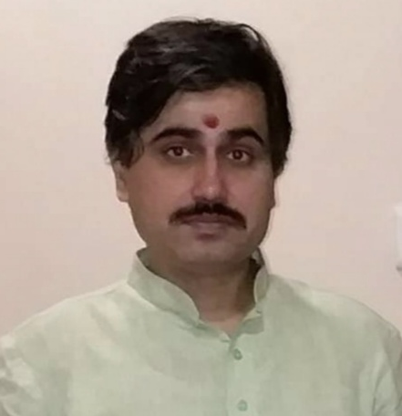
Analog Electronic Circuits (UEC301)
By
Dr.Mayank Kumar Rai
Associate Professor,
ECED,TIET,Patiala

Slide 2
Analog Electronic Circuits (UEC301)
By
Dr.Mayank Kumar Rai
Associate Professor,
ECED,TIET,Patiala

Slide 3

Subject: Analog Electronic Circuits (UEC301)
Faculty names: (1) Dr. Mayank Kumar Rai ( Associate Professor & Course Coordinator)
(2) Dr. Arun Chatterjee(Assistant Professor)
(3) Dr. Subiman Chatterjee(Assistant Professor)
Topic of today’s Lecture : Methods of BJT Biasing
Contents of this lecture are based on the following books:
Key points
Jacob Milman & and C.C.Halkias, “Integrated Electronics Analog and Digital Circuit and Systems”Second Edition.
Adel S. Sedra & K. C. Smith, “MicroElectronic Circuits Theory and Application” Fifth Edition.
Robert L. Boylestad & L. Nashelsky, “Electronic Devices and Circuit Theory” Eleventh Edition.
Base Resistor Method
Feedback Resistor Method
Voltage Divider Bias method(Self Bias)

Slide 4
Methods of BJT Biasing
Base Resistor Method
Feedback Resistor Method
Voltage Divider Bias method(Self Bias)

Slide 5
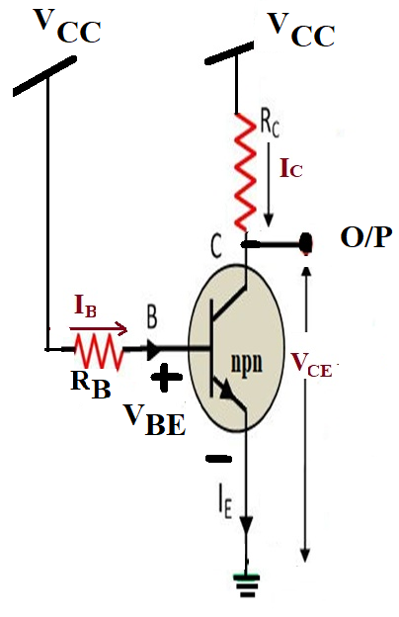
Methods of BJT Biasing
Base Resistor Method
Fig.1: Base Resistor bias ckt.

Slide 6
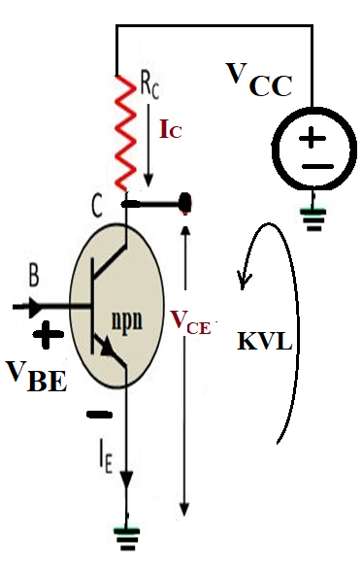
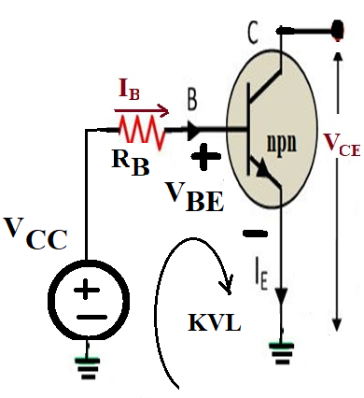
Analysis of Base Resistor Circuit (I_{B} , I_{C} & V_{CE})
Fig.2: Redrawing the input side from Fig.1(Input Network)
Fig.3: Redrawing the Output side from Fig.1(Output Network)
I_{C =} β I_{B} ............ (3)
V_{CE} = V_{CC} – I_{C}R_{C} .... (4)
V_{CC} = V_{BE} + I_{B}R_{B} ....... (1)
I_{B}= (V_{CC} - V_{BE})/ R_{B}
... (2)

Slide 7
Design of Base Resistor circuit (R_{B} & R_{C})
Fig.2: Input Network.
Fig.3: Output Network.
From Eq.(1)
R_{B} = (V_{CC} - V_{BE})/ I_{B} ... (5)
From Eq.(4)
R_{C} = (V_{CE} - V_{CC})/I_{C}... (6)

Slide 8
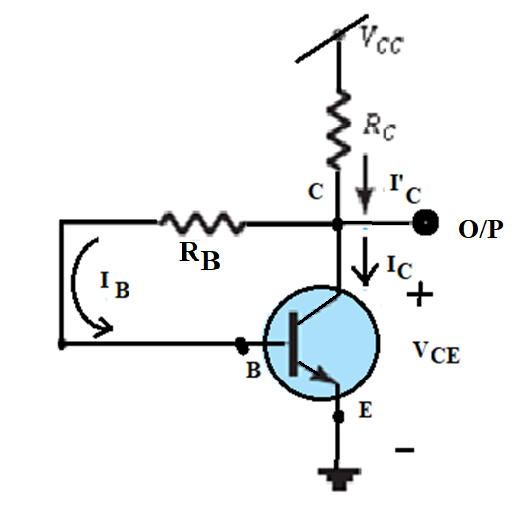
Feedback Resistor Method
V_{CE} = V_{BE} + V_{CB} ..... (7)
V_{CB} = V_{CE} - V_{BE} ....... (8)
I_{B} = V_{CB}/ R_{B} ........ (9)
I_{C}= β I_{B} ................ (10)
V_{CE} = V_{CC} – I_{C}R_{C} ..... (11)
Analysis(I_{B,}I_{C} & V_{CE})
Fig.4: Feedback Resistor ckt.

Slide 9
Design of Feedback Resistor circuit
From Eq.(9)
R_{B} = V_{CB}/ I_{B} ......... (12)
R_{C} = (V_{CE} - V_{CC})/I_{C}.... (13)
Design(R_{B} &R_{C})
From Eq.(11)
Fig.4: Feedback Resistor ckt.

Slide 10
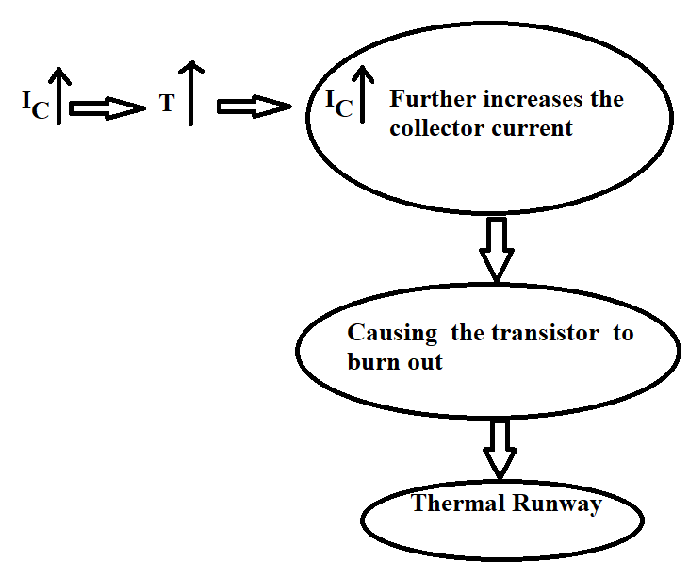
Cont...
Fig.4: Feedback Resistor ckt.

Slide 11
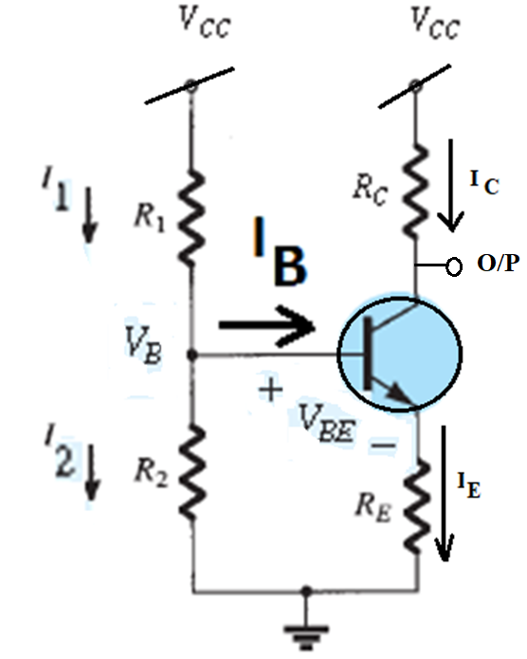

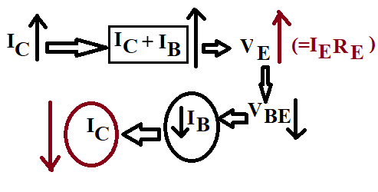
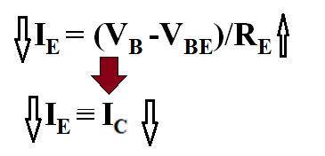
Voltage Divider Bias Method (Self Bias)
Analysis(I_{C} & V_{CE})
Approximation Method
Exact Method
Emitter resistance
Fig.5: Voltage Divider Bias ckt.

Slide 12
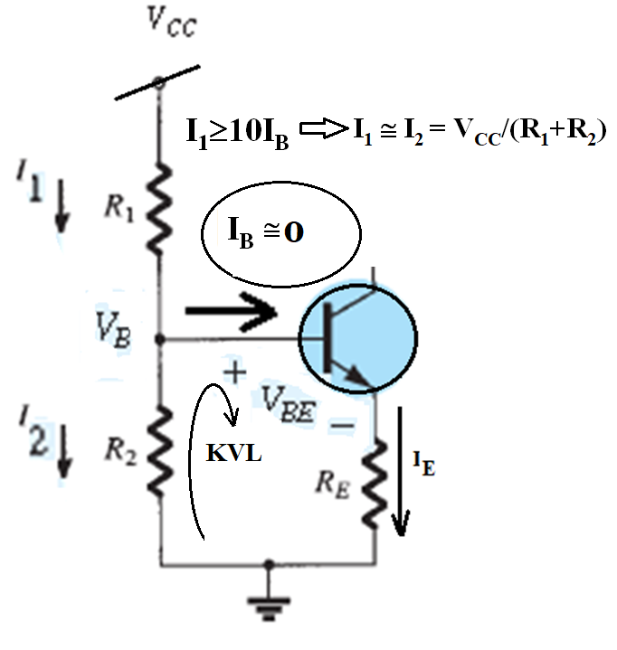
Approximation Method
V_{B} = (R₂ V_{CC})/R₁+R₂ ..............(14)
V_{B} = I_{E} R_{E} +V_{BE} ......................(15)
I_{E} = V_{E}/R_{E} = (V_{B} -V_{BE})/R_{E} ......(16)
Analysis(I_{C} & V_{CE})
Fig.6: Input Network.

Slide 13
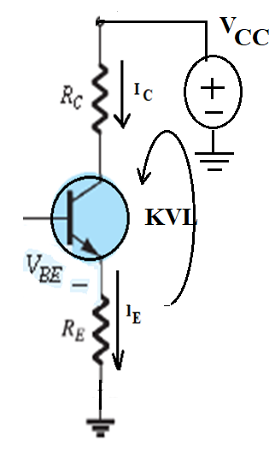

Analysis(I_{C} & V_{CE})
I_{C} ≅ I_{E} ..........(17)
V_{CE} = V_{CC} – I_{C}(R_{C}+R_{E}) .......(18)
Fig.7: Output Network.

Slide 14
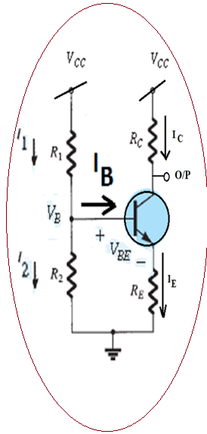
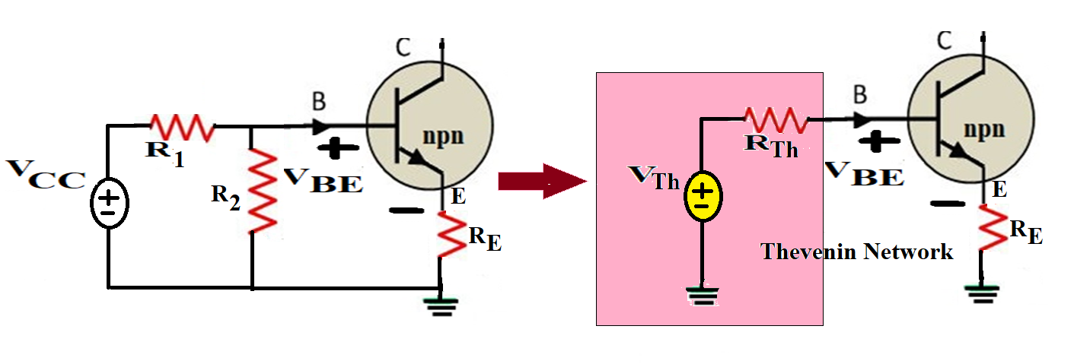
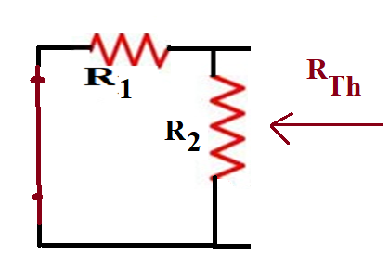
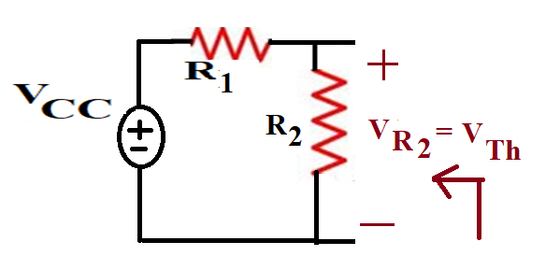
Exact Method
Analysis(I_{C} & V_{CE})
Fig. 7:Redrawing the input side of voltage divider ckt.
= (R₁ R₂)/R₁+R₂
= (R₂ V_{CC})/R₁+R₂
Fig. 8:Determining VTh .
Fig. 9:Determining RTh .

Slide 15
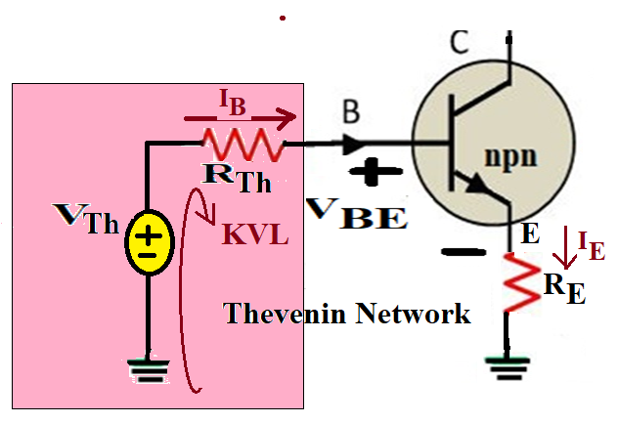

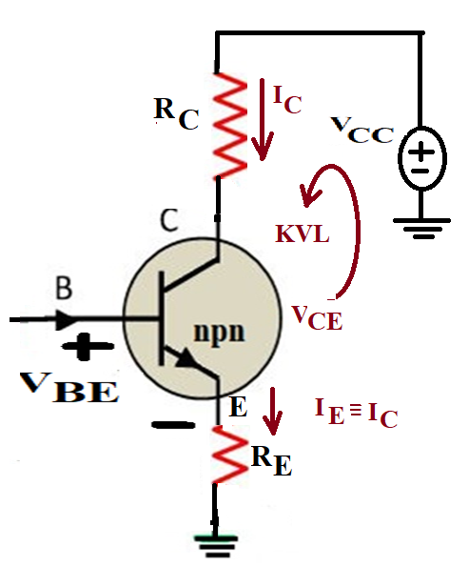
V_{Th} = I_{B} R_{Th} + V_{BE} + I_{E} R_{E} ....................(19)
I_{B} = V_{Th} – V_{BE} /{(R_{Th} +( )R_{E}}...(20)
I_{C}= β I_{B} ............ ………………..(21)
Fig. 10: Input Network.
I_{C} ≅ I_{E} ................(22)
V_{CE} = V_{CC} – I_{C} (R_{C}+R_{E}) .............(23)
Fig. 11: Output Network.

Slide 16
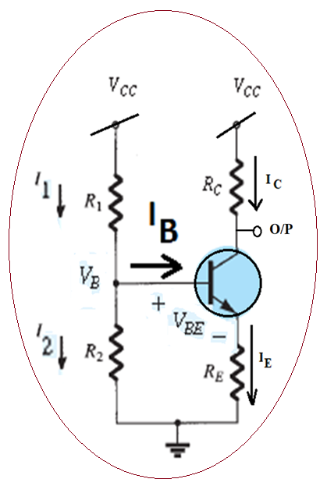


Design of Voltage Divider bias Circuit
The following steps are taken:
Step 1: from Eq.(23)
R_{E} = (V_{CC} – V_{CE} – I_{C}R_{C})/I_{C} …….(24)
Step 2:
The values of resistance R₁ and R₂ are selected so that the current I₁ flowing through R₁ and R₂ is at least 10 times I_{B} i.e.
R₂ = V_{B} / I₁ …..(25), where V_{B} = I_{E} R_{E} +V_{BE}
R₁+R₂ = V_{CC} / I₁ …….(26)
R₁ = V_{CC} / I₁ - R₂…….(27)
From Fig.5
(R_{E,} R_{1,}&R₂ )

Slide 17
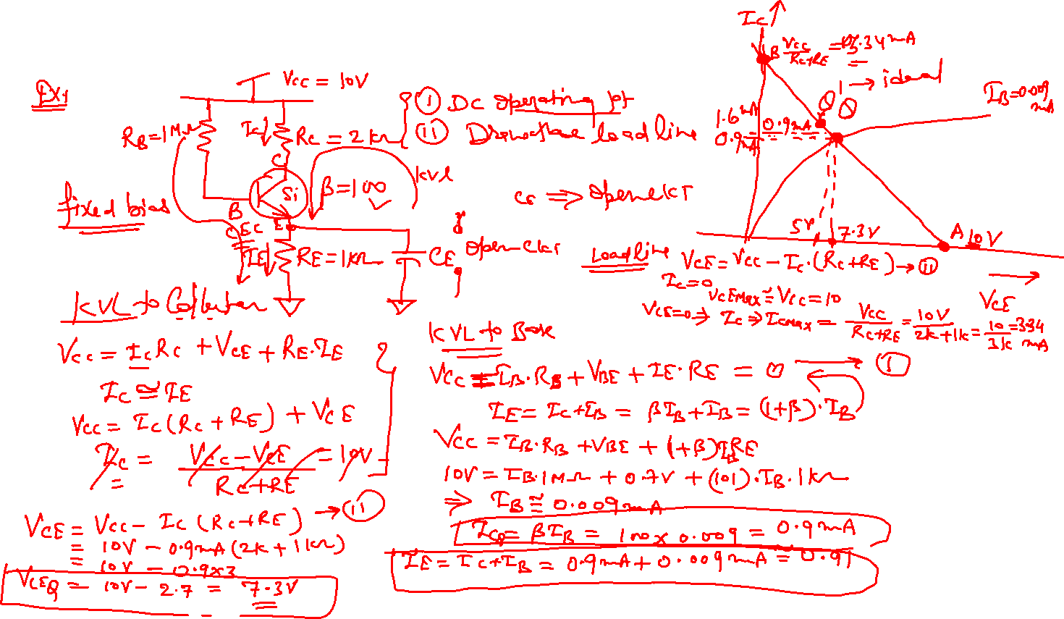

Slide 18
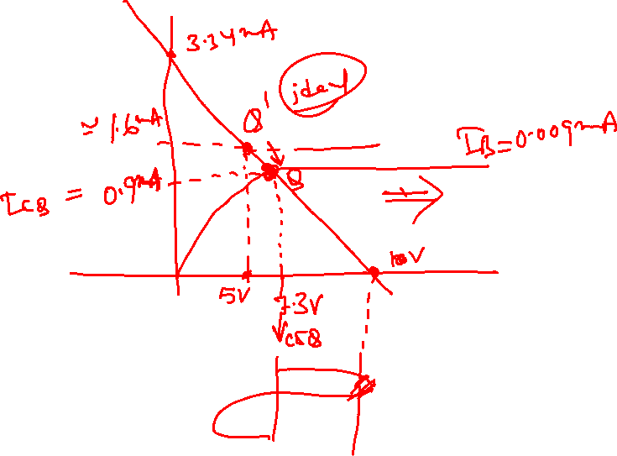

Slide 19
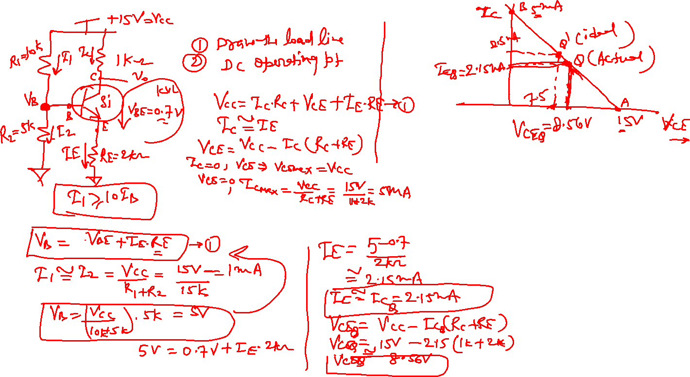

Slide 20
Thank You

